Slide 1


Huskiesearch is coming
Notes:
HuskieSearch will soon be here.

Slide 2
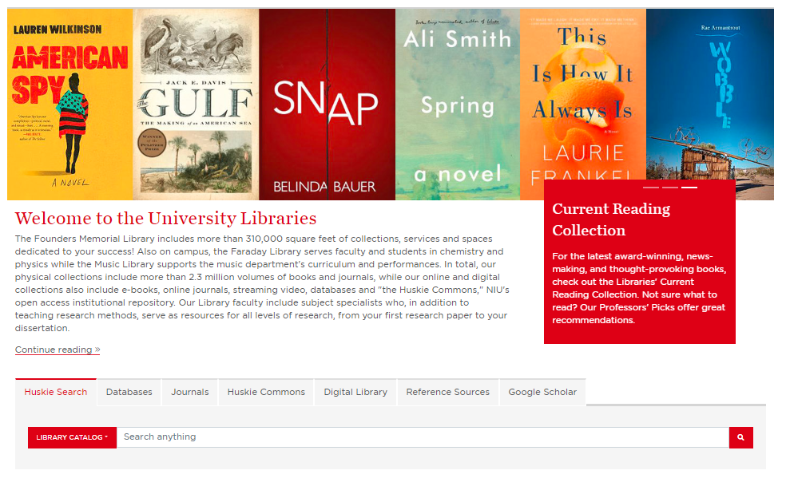
HuskieSearch
A New Look, A New discovery tool
Notes:
On June 24, 2020, Northern Illinois University Libraries is launching HuskieSearch: an exciting new way to find the resources you need.

Slide 3
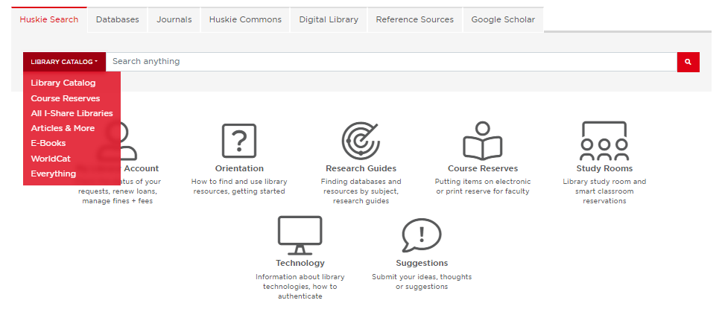
Huskiesearch changes the way you search
NIU Library catalog
I-Share
Articles & More
Everything
Notes:
You will have more options for searching. You can still look for items in our catalog or in all I-Share libraries, but you can also search for electronic articles and other online resources. And, what is more, you have the option to search “Everything” in a single-integrated search.

Slide 4
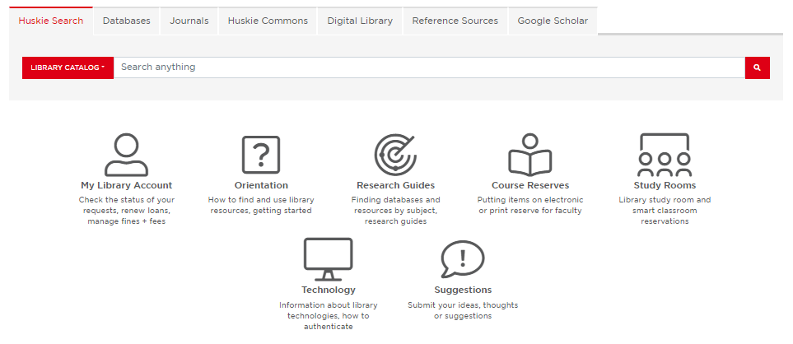

My library account
My favorites
Notes:
HuskieSearch will simplify how you request materials too. You will no longer need to login to different applications to get items from I-Share and Interlibrary Loan—all requests can be made and tracked through My Library Account.
You will be able to personalize Huskie Search. Using My Favorites, you can save and manage search results and even create an RSS feed to alert you to changes to your saved searches.

Slide 5
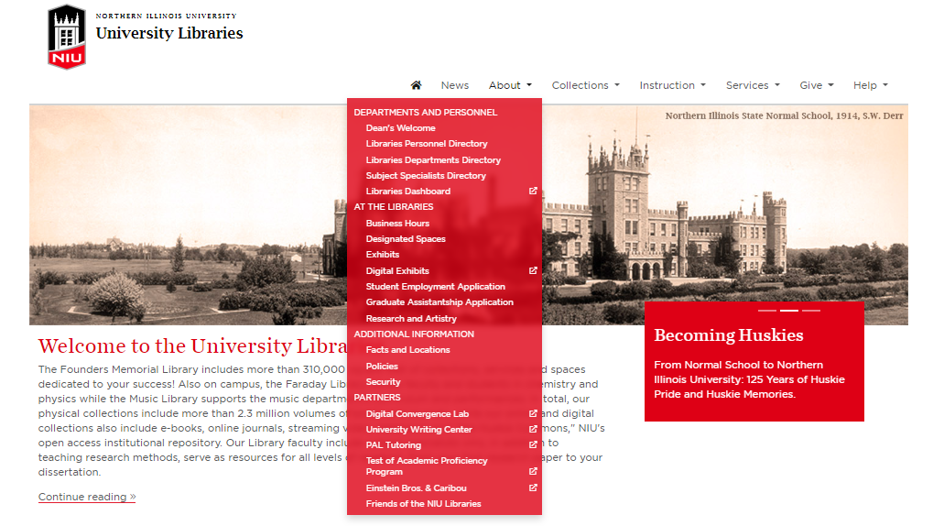
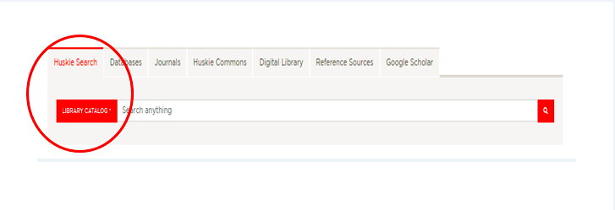
Huskiesearch
Be ahead of the pack
Notes:
Please visit our website, at library.niu.edu, to hear more about HuskieSearch in the coming weeks.
With HuskieSearch you’ll be ahead of the pack.

